Slide 1
PROJECT ACCP SEM 3
Class: ACCP 201605L
Faculty: Mr. Vo Thanh Son
Group: Unknown Group

Slide 2
Objective
The Airline Reservation System (ARS) is a software application to assist an airline with transactions related to making ticket reservations, which includes blocking, reserving, canceling and rescheduling tickets.
Programming Language: ASP.Net, Javascript, HTML, CSS
Library: Bootstrap, jQuery, Sweet Alert

Slide 3
Library
Bootstrap
Version: 3.3.7
Home page: http://getbootstrap.com/
Purpose: Design
Component and CSS: Navigation, input groups, HTML elements styled and enhanced with extensible classes, and an advanced grid system

Slide 4
Library
jQuery
Version: 2.0.0
Home page: https://jquery.com/
Purpose: Manipulation data and GUI
Function: Validation data, manipulate / transform the data returned by the server use ajax, manipulate form GUI, etc.

Slide 5
Library
Sweet Alert
Version: 1.0
Home page: http://t4t5.github.io/sweetalert/
Purpose: Show alert dialog box
Function: Show alert message, confirm box, warning box , etc.

Slide 6





Website Function
Route searching & suggestion
Ticket scheduling
Flight availability checking
User profile and ticket management
System administration

Slide 7
Conclusion
- Group has designed a complete website provides information for families.
- The group has more experience, knowledge about designing website and develop teamwork
With the results achieved of this project, the group will continue to improve the site and repair the deficiencies to improve the website and develop a website with database in order to realize the project.

Slide 8
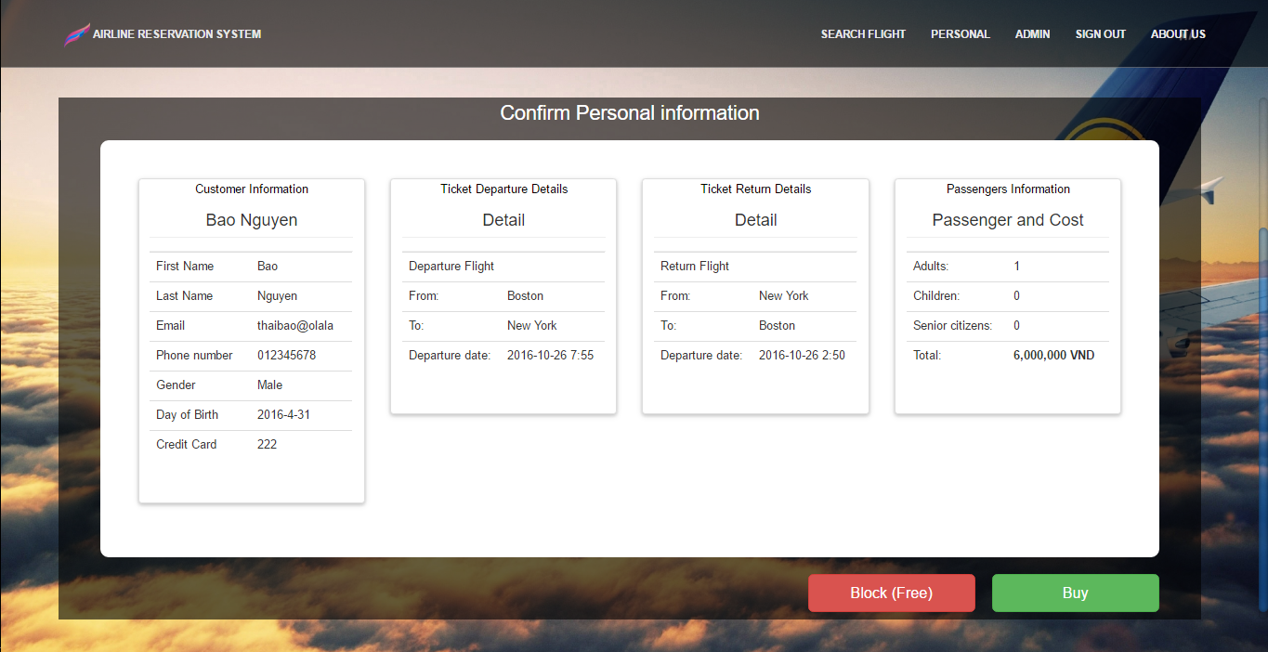
Conclusion
Result of final step of booking ticket

Slide 9
Thank you for your listening.

